Slide 1


Slide 2

PRESENTED BY
Pranav Mahajan
PRESENTED TO
Prof.Irfan Shaikh

Slide 3

Linear Regression and Correlation

Slide 4
What is linear regression?
linear regression is a method for predicting the value of a dependent variable Y, based on the value of an independent variable X.
Linear regression is one of the most commonly used predictive modelling techniques.
The important thing to note here is that the dependent variable for a linear regression model is always continuous, however, the independent variable can be continuous or discrete. A continuous variable is one that has an infinite number of possibilities.
Data requires for linearity must be numeric only.

Slide 5
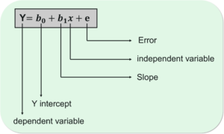
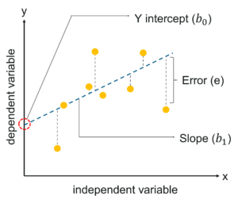
Regression Model :
Y stands for the dependent variable that needs to be predicted.
B0 is the Y-intercept, which is basically the point on the line which touches the y-axis.
B1 is the slope of the line (the slope can be negative or positive depending on the relationship between the dependent variable and the independent variable.)
X here represents the independent variable that is used to predict our resultant dependent value.
E denotes the error in the computation

Slide 6
Correlation:
Correlation is a statistical technique that can show whether and how strongly pairs of variables are related.
Correlation is used to test relationships between quantitative variables or categorical variables.
it’s a measure of how things are related.
Correlations are useful because if you can find out what relationship variables have, you can make predictions about future behavior.
Correlation ranges from -1 to +1. Negative values of correlation indicate that as one variable increases the other variable decreases. Positive values of correlation indicate that as one variable increase the other variable increases as well.
It is use to measure the relationship interms of percentage.
There are two methods:
i)Graphical method
ii)Numerical method

Slide 7
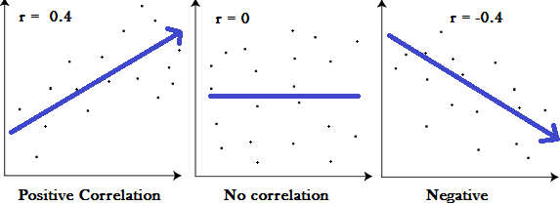
i) Graphical method(scotter plot):
Graphs showing a correlation of -1, 0 and +1
ii)Numerical method(Correlation matrix):
A correlation matrix is a table of correlation coefficients for a set of variables used to determine if a relationship exists between the variables.
The values in matrix is called correlation coefficient.
If correlation coefficient is more than 70% ,then it indicate strong
correlation.

Slide 8
Correlation coefficient:
A correlation coefficient is a way to put a value to the relationship.
Correlation coefficients have a value of between -1 and 1.
A “0” means there is no relationship between the variables at all, while -1 or 1 means that there is a perfect negative or positive correlation (negative or positive correlation here refers to the type of graph the relationship will produce).

Slide 9
R-squared (R²):
Accurancy and performance of Models:
R-squared (R²) is a statistical measure that represents the proportion of the variance for a dependent variable that's explained by an independent variable or variables in a regression model.
It may also be known as the coefficient of determination.
R-squared values range from 0 to 1 and are commonly stated as percentages from 0% to 100%.
Greater than 70% R-squared (R²) value indicate good model.
Adjusted R-squared (R²):
Some interpretation as R-squared (R²) , only it can not be manipulated (Adding rows and columns).F

Slide 10
Assumptions:
Linearity
Normality
Homoscedarticity(Constant Varience)
Model Error(it has to be independently , identically and normally distributed. )
The residual data of the simple linear regression model is the difference between the observed data of the dependent variable y and the fitted values ŷ.
Residual error = y - ŷ, where y is the original value and ŷ is the computed value.

Slide 11
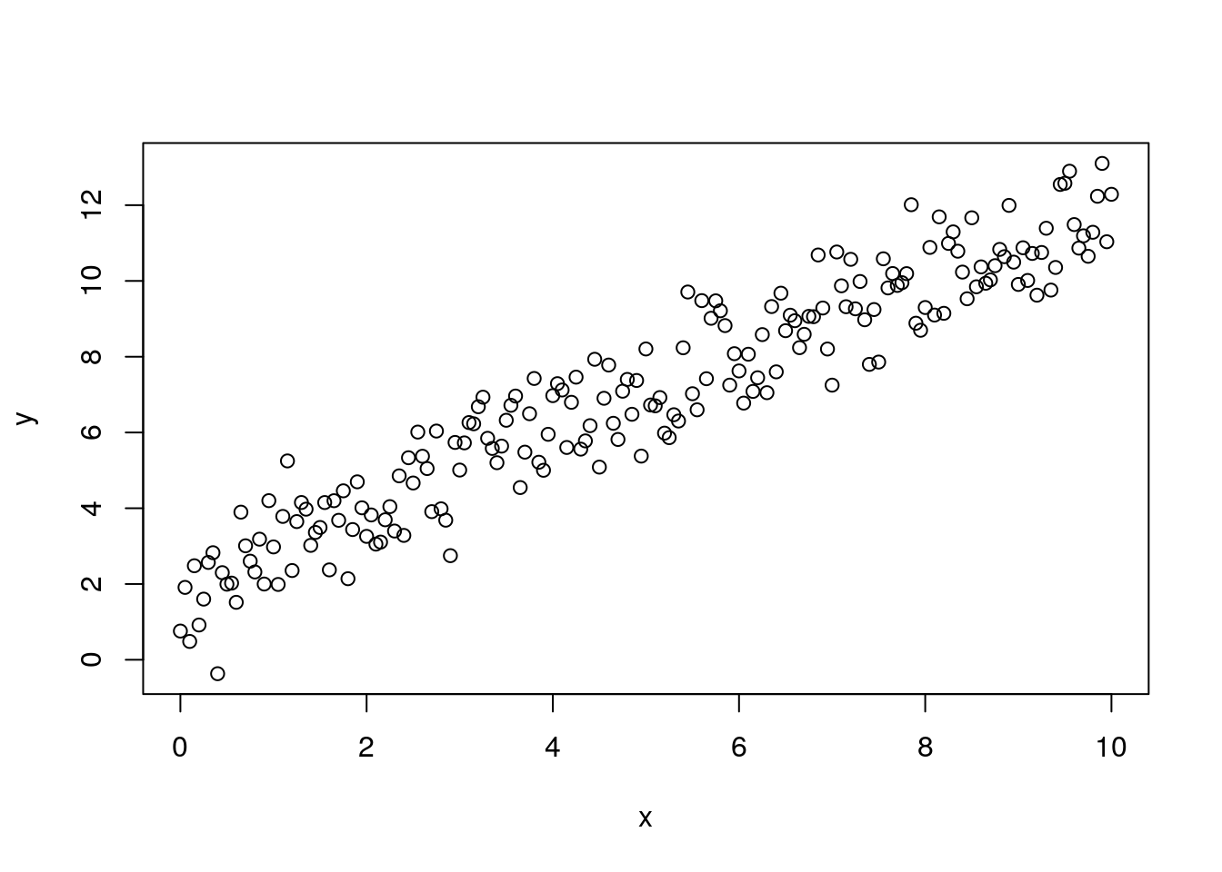
1)Linearity:

Slide 12
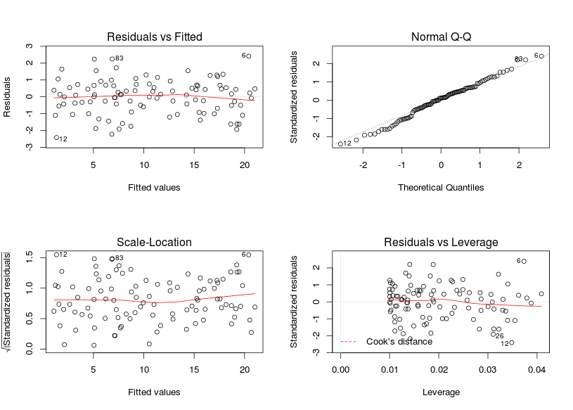
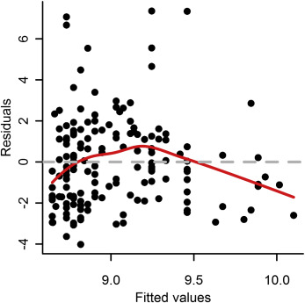
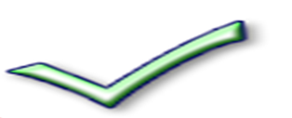
2)Normality:

Slide 13
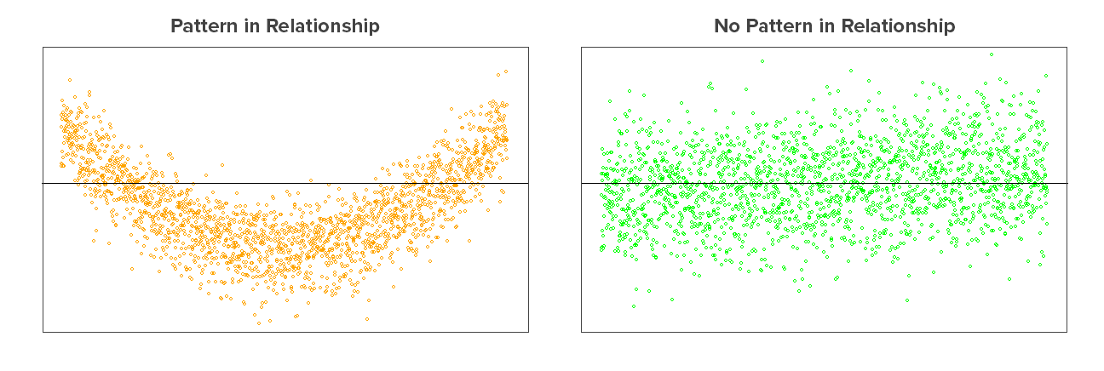
3) Homoscedarticity(Constant Varience):

Slide 14

4)Model Error:

Slide 15
Multiple Linear Regression

Slide 16
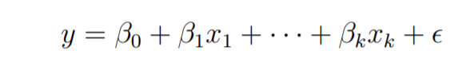
Multiple Linear Regression:
It is the most common form of Linear Regression. Multiple Linear Regression basically describes how a single response variable Y depends linearly on a number of predictor variables.
Multiple linear regression is an extension of simple linear regression used to predict an outcome variable (y) on the basis of multiple distinct predictor variables (x).

Slide 17
Multiple Linear Regression:
Collinearity :
It is use to find the relationship between X1 and X2,is called collinearity.
Multicollinearity :
When we have more than 1 collinearity in the data then we say
we have multicollinearity.
If multicollinearity is exist in the data then the output is not
reliable or inaccurate.
To threshold or remove multicollinearity from the model,we take the
help of variance inflation factor (or VIF).

Slide 18
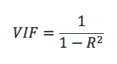
Variance Inflation Factor (or VIF):
Variance inflation factors measure the inflation in the variances of the parameter estimates due to collinearities that exist among the predictors.
If the value of VIF is greater than or equal to 10% then it indicate no multiple collinearity.

Slide 19
Procedure of VIF:
Find the VIF value of each and every variable coming in the model and select the variable which have highest value of VIF (means more than 10%), then that variable is remove from the model.
And rerun the model again and so on.
The process will stop when none of the variable present in the model and all VIF values are less than 10%(VIF < 10%).

Slide 20
Variable Selection Method (automation) :
There are 3 methods for variable selection in MLR :
Forward Method
Backward Method
Stepwise Method

Slide 21
1) Forward Method:
It is iteration method, In 1st iteration we check P-value(probability value) of intercept.If P-value is less than α(0.05) then only intercept is added in model.
In the 2nd iteration, we check P-value for all variables and select variables which have P-value is less than α(0.05) then only that variables are add in the model and so on.
The process will stop when none of the variable have P-value less than α.

Slide 22
2) Backward Method:
It is iteration method, In 1st iteration we check P-value(probability value) of all variables. And create model.
In the 2nd iteration, we remove variable which have P-value is greater than α(0.05) and so on.
The process will stop when none of the variable have P-value greater than α.
3) Stepwise Method:
In stepwise method, first we do forward method then we do backward method.

Slide 23
1) DurbinWatsonTest():
.
The DurbinWatson Test() examines whether the errors are autocorrelated with themselves..
The null hypothesis (H0) is that there is no autocorrelation among residuals, i.e., they are independent
2) Non Constant Variance Score Test():
The ncvTest() provides us with another test of the homoscedasticity assumption.
This test is often called the Breusch-Pagan test
The null hypothesis (H0) is that there is constant variance, (H1) there is non-constant variance.

Slide 24
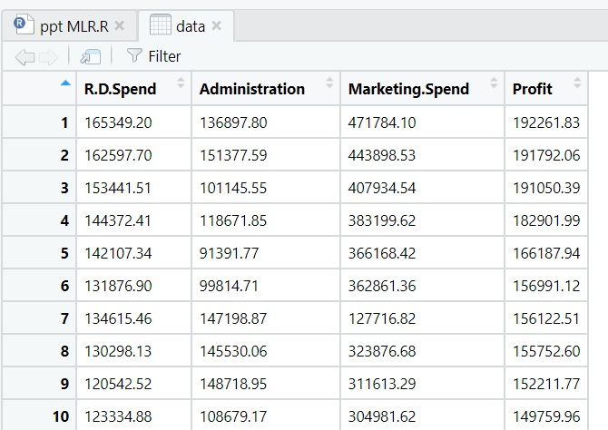
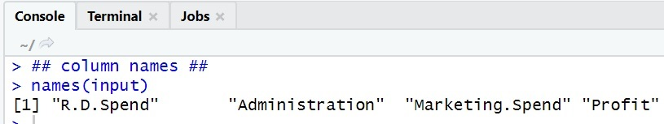
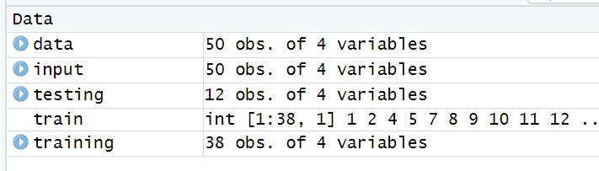
Steps of multiple linear regression for prediction: Data https://www.kaggle.com/suman10586/50-startups
1
Data insert for start process data<-read.csv(“file path/50_Startups.csv")
2
Show variables name or columns name names(input)
3
partition of data for testing of prediction set.seed(23) ; library(caret) train<- createDataPartition
(input$Profit,p=0.7,list=FALSE) training<-input[train,] ; testing<-input[-train,]

Slide 25
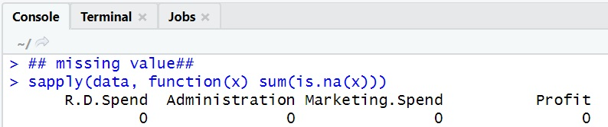
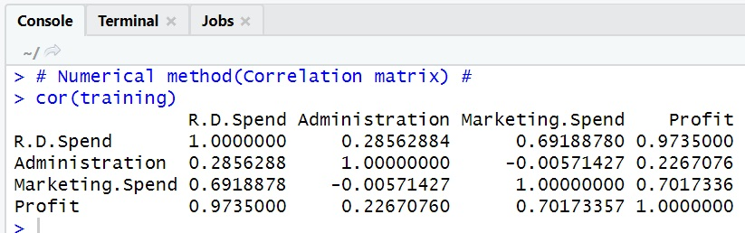
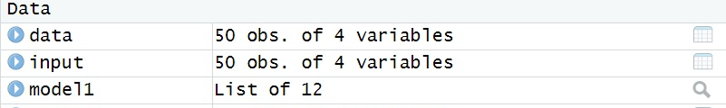
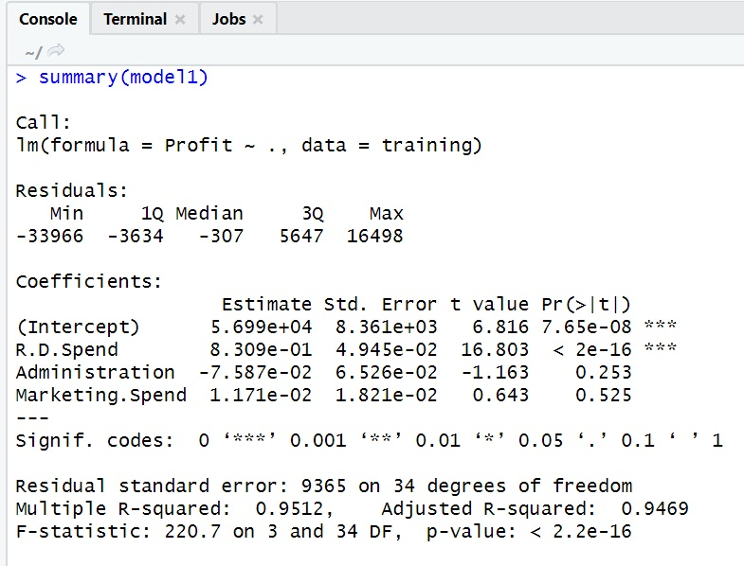
4
missing value sapply(data, function(x) sum(is.na(x)))
5
Correlation matrix (Numerical mathod) cor(training)
6
7
Summarise data for checking model generated values summary(model1)
Create Regression Model model1 <- lm(Profit~., data = training)

Slide 26
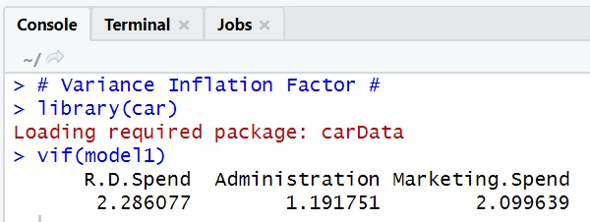
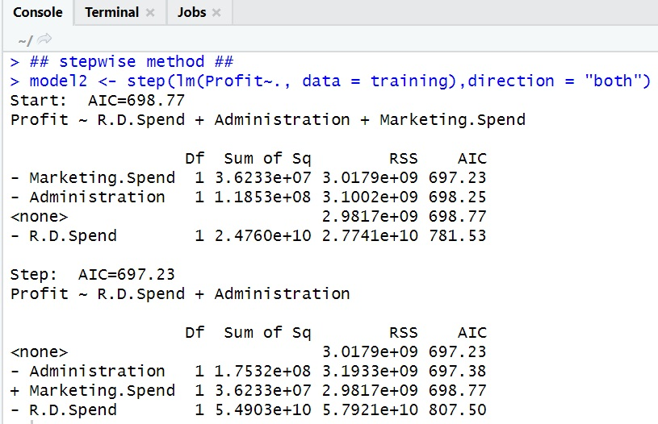
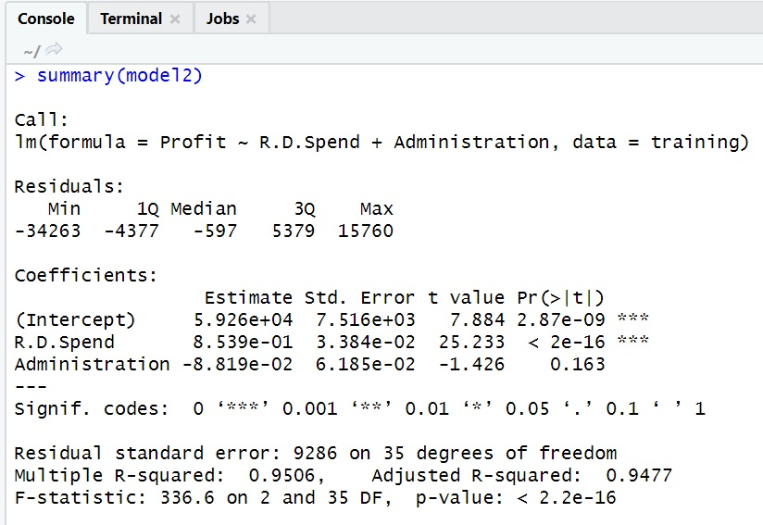
8
Create Variance Inflation Factor using library “car” - library(car)
9
VIF values of each variables vif(model1)
10
11
Summarise data for checking model generated values summary(model2)
Doing stepwise regression model2 <- step(lm(Profit~., data = training),direction = "both")

Slide 27
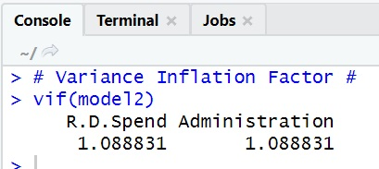
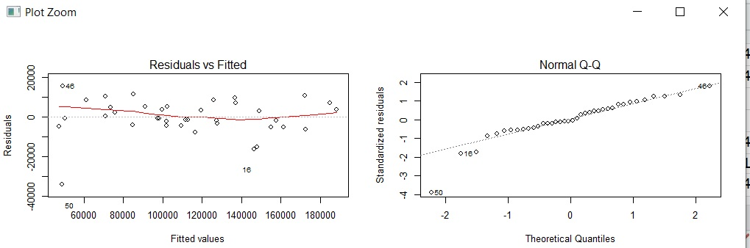
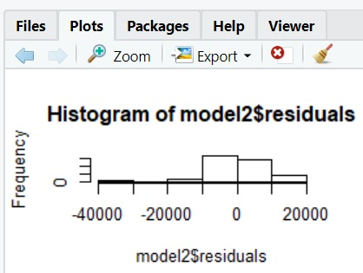
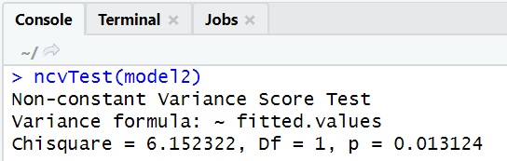
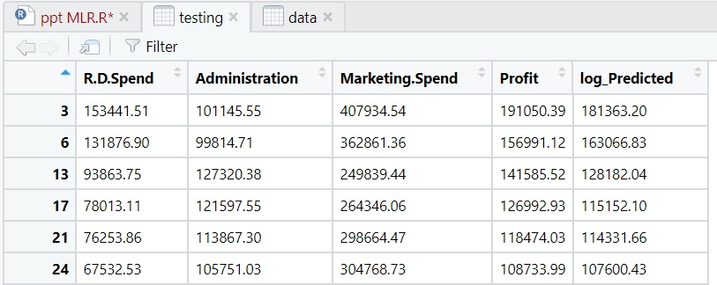
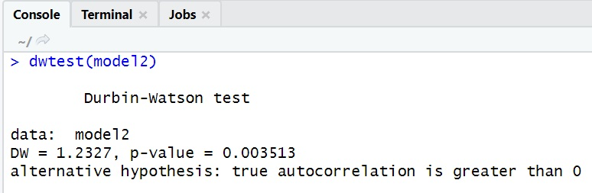
13
Predicton Method on entire testing data set testing$log_Predicted<-predict(model2,testing)
14
ncvTest(model2) #variance constant it is non constant variance score test
dwtest(model2);hist(model2$residuals); #Model error
par(mfrow=c(2,2)) ; plot(model2) # Normality
Assumpution of model :
12
VIF values of each variables vif(model2)

Slide 28
Logistic Regression

Slide 29
Logistic Regression:
Logistic regression is a method for fitting a regression curve, y = f(x), when y is a categorical variable.
The predictors can be continuous, categorical or a mix of both.
It is used to predict a binary outcome (1 / 0, Yes / No, True / False)
Logistic Regression is part of a larger class of algorithms known as Generalized Linear Model (glm).

Slide 30
Performance of Logistic Regression Model:
AIC (Akaike Information Criteria) :–
The analogous metric of adjusted R² in logistic regression is AIC. AIC is the measure of fit which penalizes model for the number of model coefficients. Therefore, we always prefer model with minimum AIC value.
Null Deviance and Residual Deviance :–
Null Deviance indicates the response predicted by a model with nothing but an intercept. Lower the value, better the model. Residual deviance indicates the response predicted by a model on adding independent variables. Lower the value, better the model.

Slide 31
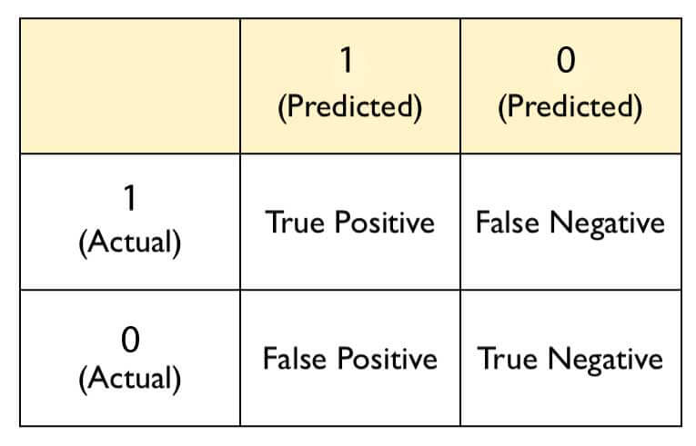
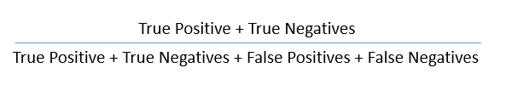
Confusion Matrix :-
It is nothing but a tabular representation of Actual vs Predicted values. This helps us to find the accuracy of the model and avoid overfitting. This is how it looks like:
You can calculate the accuracy of your model with:

Slide 32
True Positive Rate (TPR) :-
It is also known as Sensitivity or Recall.
It indicates how many positive values, out of all the positive values, have been correctly predicted.
The formula to calculate the true positive rate is (TP/TP + FN). Also, TPR = 1 - False Negative Rate.
False Positive Rate (FPR) :-
It indicates how many negative values, out of all the negative values, have been incorrectly predicted.
The formula to calculate the false positive rate is (FP/FP + TN). Also, FPR = 1 - True Negative Rate.

Slide 33
True Negative Rate (TNR) :-
It is also known as Specificity.
It indicates how many negative values, out of all the negative values, have been correctly predicted.
The formula to calculate the true negative rate is (TN/TN + FP).
False Negative Rate (FNR) :-
It indicates how many positive values, out of all the positive values, have been incorrectly predicted.
The formula to calculate false negative rate is (FN/FN + TP).

Slide 34
Precision:-
It indicates how many values, out of all the predicted positive values, are actually positive.
It is formulated as:(TP / TP + FP).
F Score:-
F score is the harmonic mean of precision and recall.
It lies between 0 and 1. Higher the value, better the model.
It is formulated as
2((precision*recall) / (precision+recall)).

Slide 35
Receiver Operator Characteristic (ROC)
ROC determines the accuracy of a classification model at a user defined threshold value.
It determines the model's accuracy using Area Under Curve (AUC).
The area under the curve (AUC), also referred to as index of accuracy (A) or concordant index, represents the performance of the ROC curve.
Higher the area, better the model. ROC is plotted between True Positive Rate (Y axis) and False Positive Rate (X Axis).
In this plot, our aim is to push the red curve (shown below) toward 1 (left corner) and maximize the area under curve. Higher the curve, better the model.

Slide 36
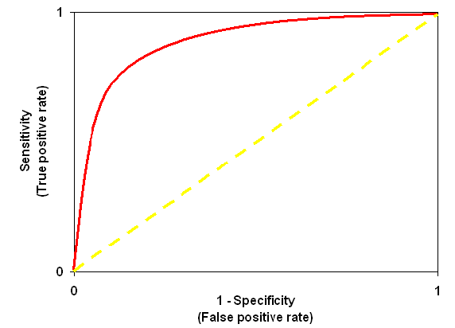
The yellow line represents the ROC curve at 0.5 threshold. At this point, sensitivity = specificity.

Slide 37
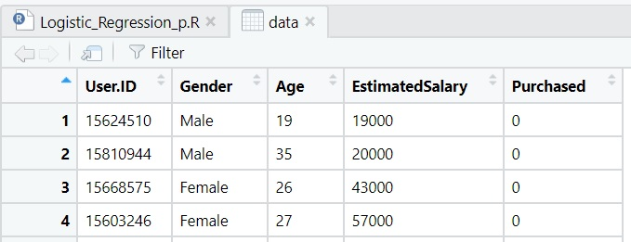
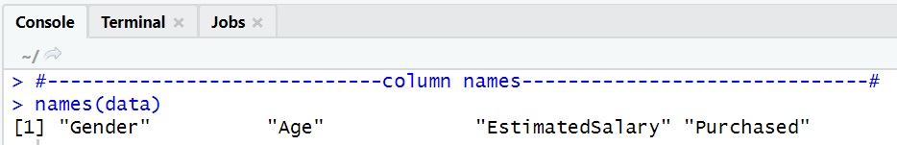
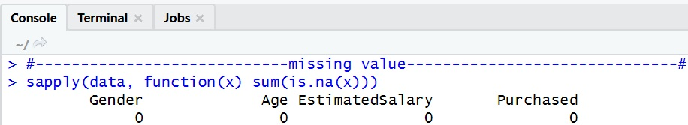
Steps of Logistic regression for prediction: Data from- https://www.kaggle.com/suncor/socialadv/Social_Network_Ads.csv
1
Data insert for start process data<-read.csv(“file path/Social_Network_Ads.csv")
2
Removing irreleavent column data <- data[-1]
3
4
missing value sapply(data, function(x) sum(is.na(x)))
Column names names(data)

Slide 38
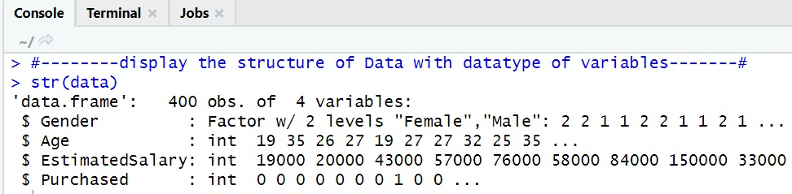
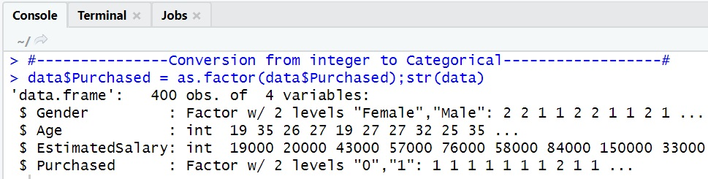
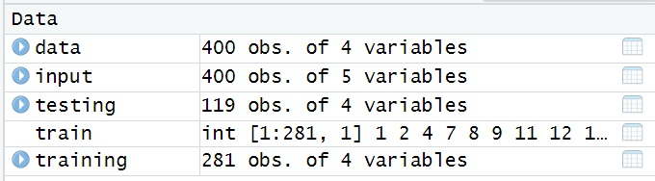
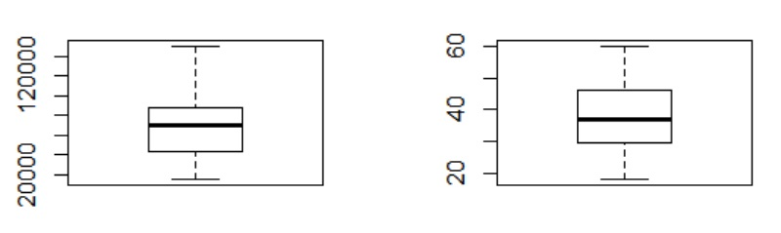
5
display the structure of Data with datatype of variables str(data)
6
Conversion from integer to Categorical data$Purchased = as.factor(data$Purchased);str(data)
7
8
Outliers in Boxplot:- par(mfrow=c(1,2)) boxplot(data$EstimatedSalary) boxplot(data$Age)
partition of data for prediction set.seed(251);library(caret);train<-createDataPartition(data$Purchased,p=0.7,list=FALSE);training<-data[train,];testing<-data[-train,]

Slide 39
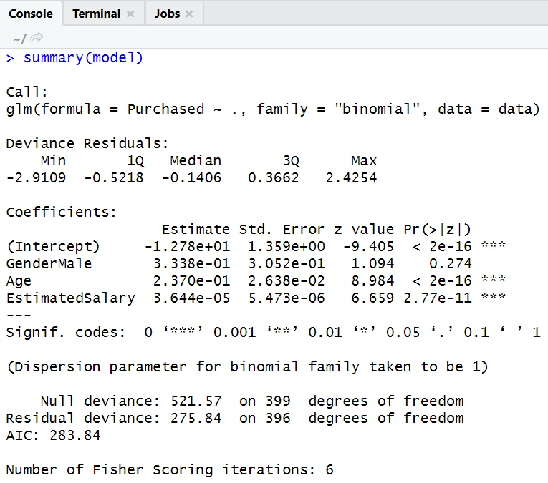
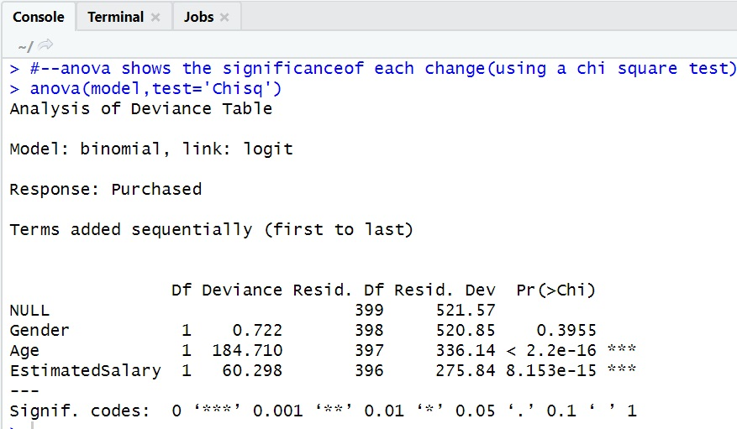
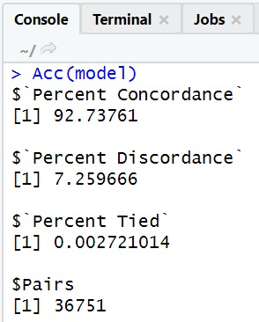
9
Model Creation:glm model = glm(Purchased ~., family = 'binomial', data = data)
10
Summarise data for checking model generated values summary(model)
11
12
Accuracy of model Acc(model)
anova shows the significanceof each change(using a chi square test) anova(model,test='Chisq')

Slide 40
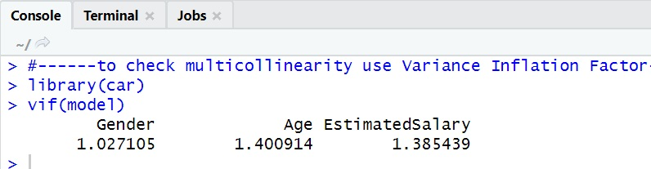
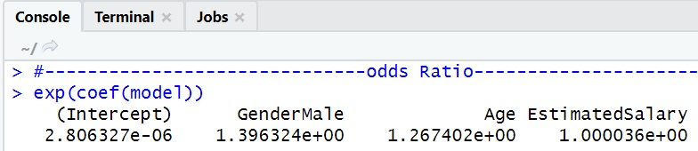
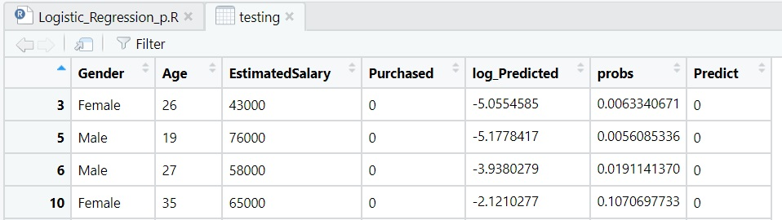
13
VIF values of each variables library(car);vif(model)
14
odds Ratio summary(model)
15
16
type='response'-interms of probability testing$probs <-predict(model, testing, type='response'); testing$Predict<-as.factor(ifelse(testing$probs>0.70,1,0))
Predicton Method on testing data set testing$log_Predicted<- predict(model,testing)

Slide 41
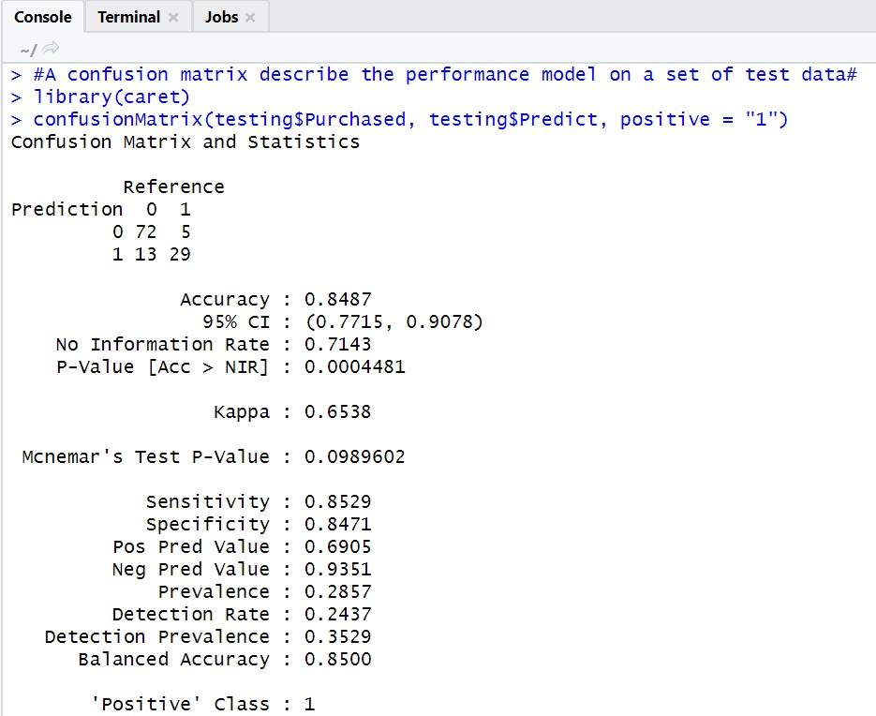
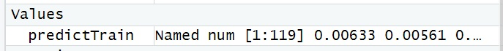
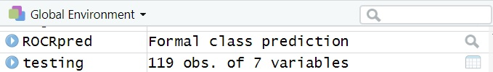
17
confusion matrix describe the performance model on a set of test data ; library(caret) confusionMatrix(testing$Purchased, testing$Predict, positive = "1")
18
ROC Curve can help in deciding the best threshold value use library library(ROCR) ; library(ggplot2)
19
20
Predicton Method on testing data set ROCRpred<-prediction(predictTrain, testing$Purchased)
Make predictions on test set predictTrain<- predict(model,testing ,type="response")

Slide 42
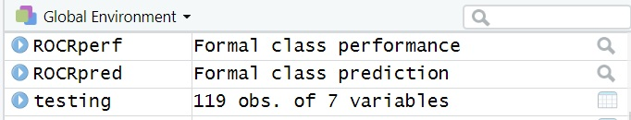
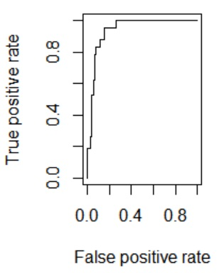
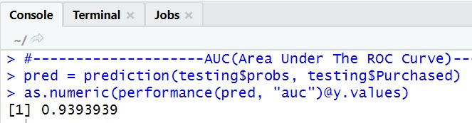
21
Performance function ROCRperf <- performance(ROCRpred, "tpr", "fpr")
22
ploting Roc Curve plot(ROCRperf)
23
AUC(Area Under The ROC Curve) pred <- prediction(testing$probs, testing$Purchased)as.numeric(performance(pred, "auc")@y.values)

Slide 43
Conclusion

Slide 44
Thank you!

